Slide 1
Archivematica Camp York – April 2017
Richard van Heest

Slide 2
Overview of an ingest into Archivematica
Part 1

Slide 3
Based on OAIS model

Slide 4
Archivematica ingest

Slide 5
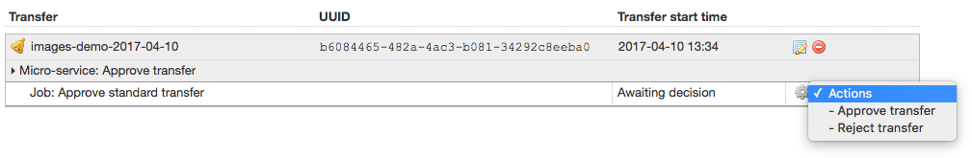
Archivematica ingest
Decision points along the ingest workflow

Slide 6
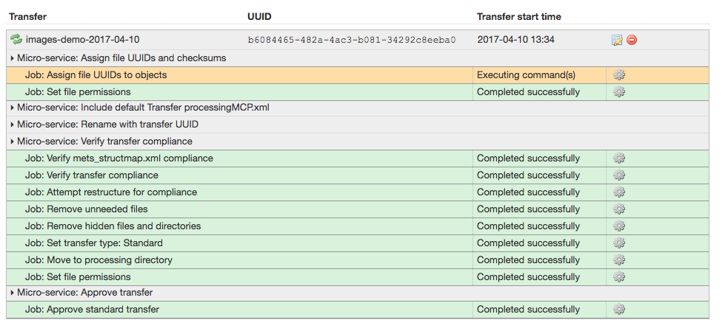
Archivematica ingest

Slide 7
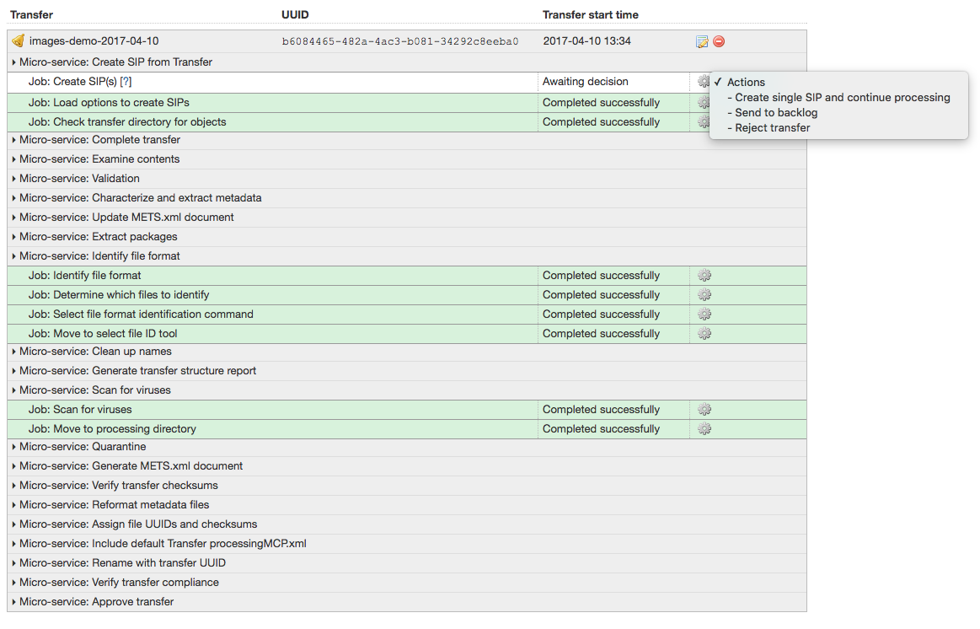
Archivematica ingest
Creating a SIP?
Single SIP and continue
Create SIP and move to ingest tab
Send to backlog
Create multiple SIPs by hand and ingest them separately

Slide 8
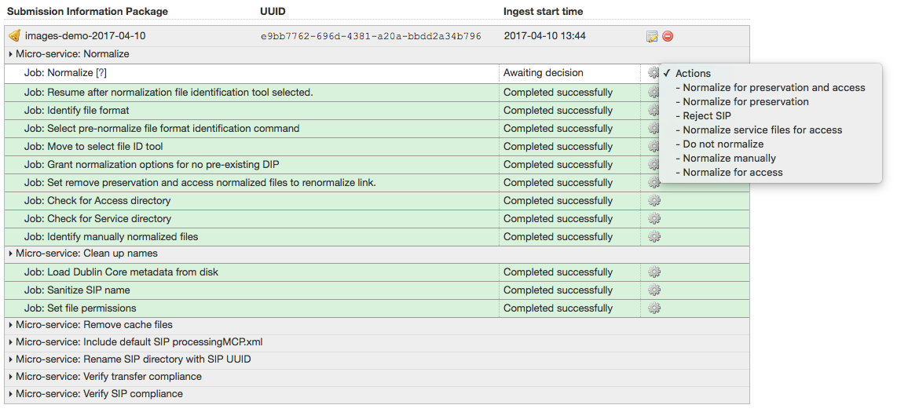
Archivematica ingest
Normalization

Slide 9
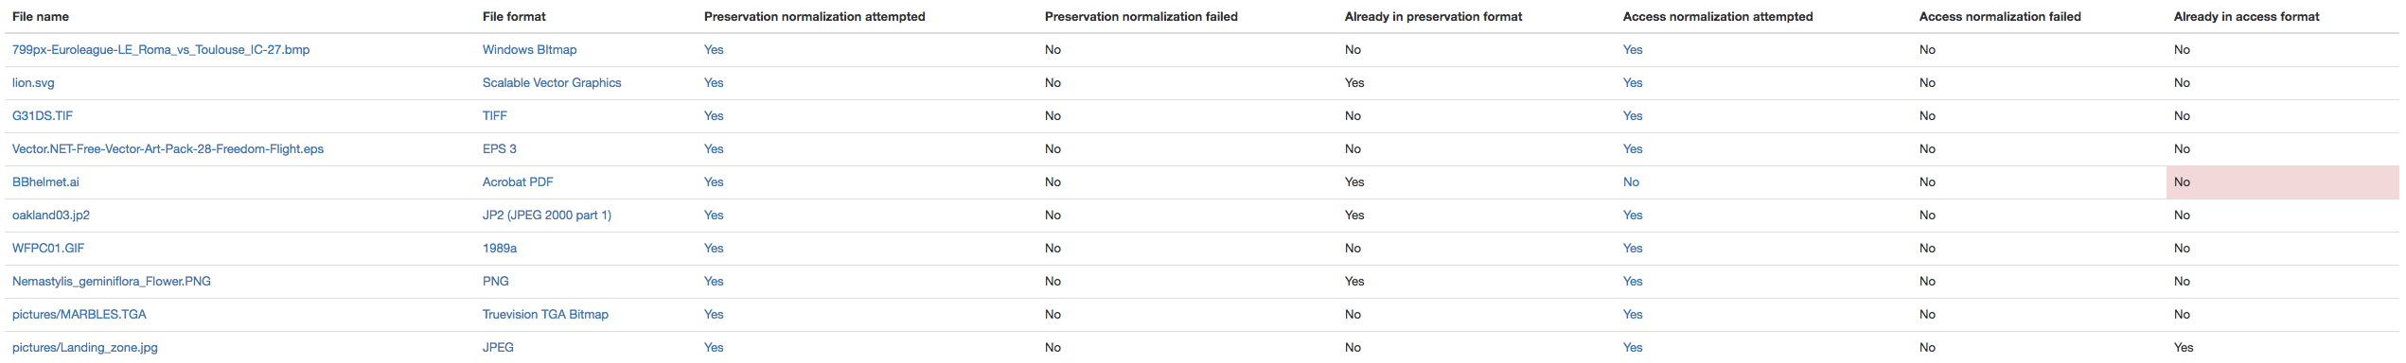
Archivematica ingest
Normalization report

Slide 10

Archivematica ingest
Choice between storing an AIP/DIP/both
Choice for storage location (if configured)
Layout of AIP store looks very similar to easy-bag-store!
Hook up to own storage system

Slide 11
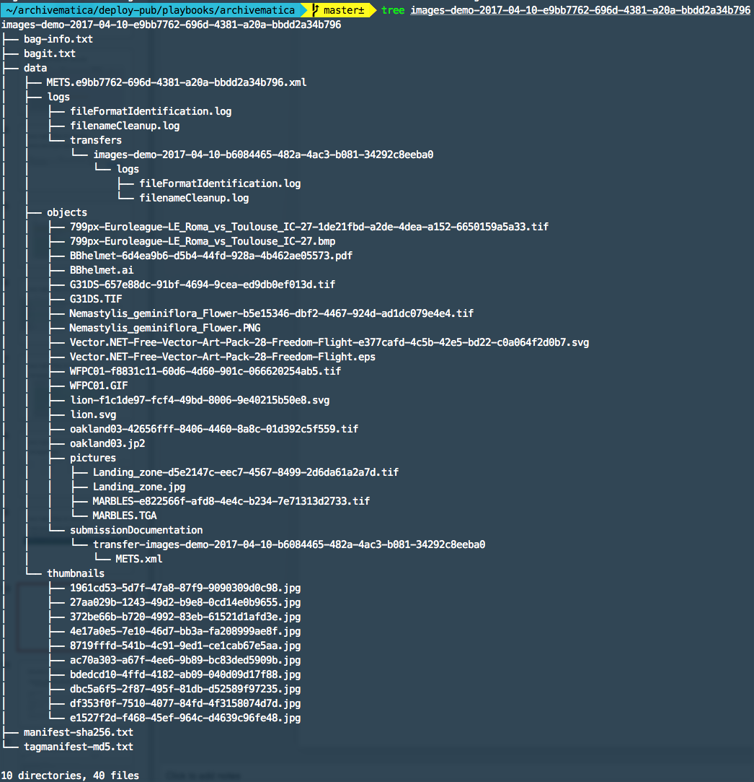

Slide 12
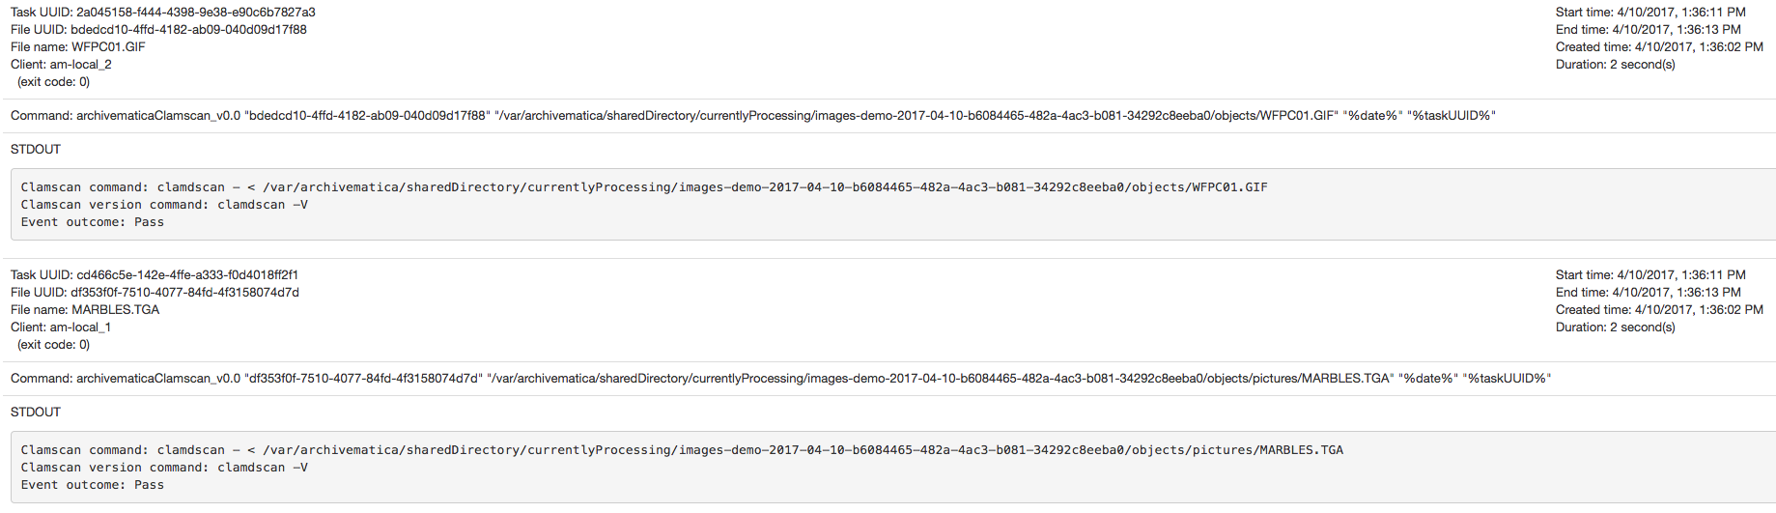
Detailed output per job (virus scan)

Slide 13
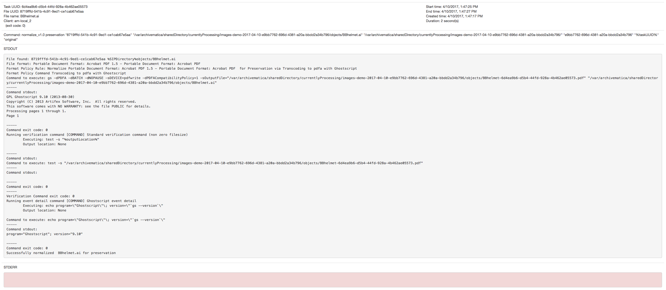
Detailed output per job (normalization)

Slide 14
Archivematica ingest
Conclusions
‘easy-ingest-flow’ on steroids
More control over what is ingested (split a transfer into multiple SIPs)
Decision points along the way
Normalization
Difference AIP/DIP
Integration with ‘easy-bag-store’ seems feasable
Large amount of output per job

Slide 15
METS file
Part 2

Slide 16
METS file
METS (Metadata Encoding and Transmission Standard): wrapper for PREMIS
PREMIS (preservasion metadata implementation strategies) standard for metadata about objects
Transfer METS file contains data about original transfer (which might end up in multiple SIPs)
METS makes complex queries over many datasets possible
Archivematica stores way more in METS than it uses. Just for later usage

Slide 17
METS file
Layout
METS header
info about the METS file (who created it and when, last modified (for versioning))
descriptive metadata
container for Dublin Core metadata
more than 1 of these for versioning and such
administrative metadata
technical metadata container with PREMIS object
rights metadata container with PREMIS object
provinance (PREMIS events/agents)
events linked to agents (institution, logged-in user, digital preservation system)

Slide 18
METS file
Layout (cont.)
file section
everything AIP in detail
tells role of particular object (original, license, submissionDocument, preservation, ...)
links files to related files using groupIDs
structural map
layout of the AIP in terms of directories and files/items

Slide 19
METS file
All easy metadata files in one single format
Library of Congress Standard
Possibility in easy
Replace internal metadata files like EMD/AMD/files.xml with single METS file

Slide 20
Microservice architecture???
Part 3

Slide 21
Microservice architecture
Small, stand-alone services
Focused on one task only (examples: easy-bag-store, easy-bag-index)
Individually deployable
Ability to run in separate machine/container from the rest of the application
Communication via HTTP/REST API

Slide 22
Microservice architecture???

Slide 23
Microservice architecture???
Archivematica microservice consists of a series of jobs that run sequentially
1 job = 1 Python script
Jobs ‘glued’ together using small framework

Slide 24
Microservice architecture???
Microservices focus on one task only (normalize, scan for virussus, etc.)
Not individually deployable
Part of bigger Archivematica framework
Output of each job is stored to database for other jobs to get as input

Slide 25
Miscellaneous
Part 4

Slide 26
Validation microservice
New in upcoming version
Make sure mkv files are valid
Enforce technical details of the video
Conform to your own policies (size, resolution, etc.)
Plans to do similar things with PDF and other formats

Slide 27
Deployment, code & documentation
Ubuntu/CentOS/Redhat packages
Vagrant/Ansible roles
All code open source on GitHub
Documentation on Archivematica wiki

Slide 28
Automation tools
Setting defaults for decision points
Auto-ingest from a transfer area
Tools available on GitHub
Automated workflows can be triggered differently per transfer location

Slide 29
Conclusion
Part 5

Slide 30
Conclusion
Strictly follows OAIS model and standards such as PREMIS, METS, BagIt, Dublin Core, PRONOM, etc.
Many microservices/jobs in ingest process
Large amount of output data (including all input, commands and output)
Store metadata in METS standard
Microservices not individually deployable
Sequences of Python scripts
Deployment via packages or vagrant/ansible
Automation tools

Slide 31
Archivematica Camp York – April 2017
Richard van Heest

